Slide 1


Post Graduate Diploma in Cloud Technology
Oberoi Center of Excellence ,RTM Nagpur University
Session 2021-22
SMART HEALTHCARE SYSTEM
Under Guidance of
Prof Arshad Sir, Prof Akhilendra Sir.
Team Members
Aditya Jogwar.
Aparna Khadatkar.

Slide 2
HEALTHIFY
PRESENTED BY:
ADITYA AND APARNA

Slide 3
TABLE OF CONTENTS
1
2
Introduction
Objective
3
4
Design and Development
Methodology

Slide 4
ABSTRACT
Treatments and Precautions. | Symptom Checker .
Support Information . | Personal Nutrition Plans according to diet.

Slide 5

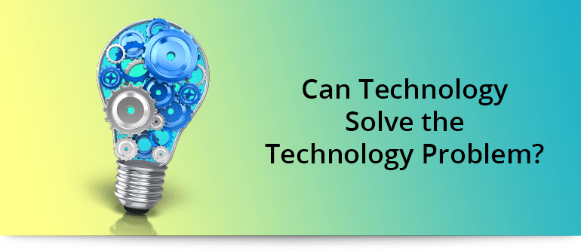
Healthcare has been associated with in-person consultations for decades. This has been a problem that obligates the patients to run to the nearest healthcare center for treatment.
Now, the COVID outbreak and lockdowns made it even worse. So, what do they do if they need to see a doctor and have an emergency?
The need for remote access or virtual consultations is the need of the hour, which needs to be taken care of to stay one step ahead in the technology adoption race.

Slide 6

SOLUTION
Mobile app developers continue to grow the flexibility and performance abilities of these remote-oriented platforms. This creates a reliable experience for medical experts to provide quality care and advice to patients from miles away.

Slide 7
INTRODUCTION
Designing an health Application/website that will help users to access it any where reducing time wastage and increasing efficiency.
Artificial Intelligence is estimated to take over the world economy by 2030 and the greatest impact will be in the Healthcare.
Why is AI used in Healthcare?
Because of high availability of data.
Design of complex algorithms which are used in ML.
Churn Reduction .
Machine Learning is a subset of AI.

Slide 8
OBJECTIVE
Reducing time wastage searching for the data and boosting both engagement and satisfaction rates.
The app/web app should be consumer driven and satisfactorily match the expectations.
Design for simplicity , Scalability and sustainability(Auto-update feature).
Secure app and user friendly in nature.

Slide 9
DETAILS
Details about the applications and its features .

Slide 10
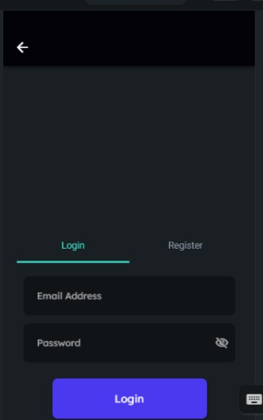
Login/ Authentication
App will contain a login button through which the application will authenticate the user.
User needs to enter his/her email address And Password to sign in.

Slide 11
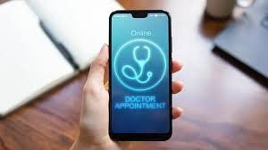
Inside the App
The app will contain an option to book
appointments which will help the user to treat them remotely rather than going to clinic.

Slide 12
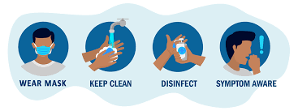
Precautions
All the precautions and measures that need to be taken while undergoing treatment will also be mentioned.

Slide 13
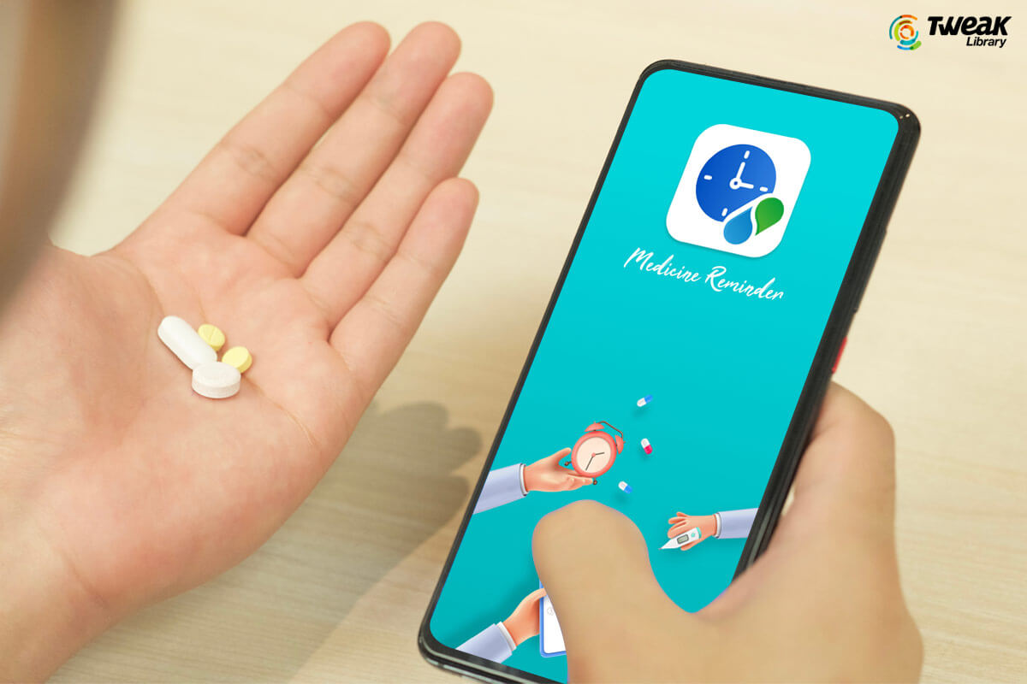
Notifications
Users would also get timely notifications and reminders that need to be taken while undergoing treatment will also be mentioned.

Slide 14


TREATMENTS
The app will provide the treatment options according to user needs. It will contain text as well as video tutorial to guide the user.
Some of the most common symptoms will be listed and will contain some home treatments as well for users who need home made treatments instead of doctor consultations.

Slide 15
Methodology
FRONTEND FlutterFlow
BACK END
FireBase

Slide 16
CONCLUSION
1.What is the Future of Technology in Healthcare — Bright!
2.There’s no denying that the healthcare industry has come a long way as technology continues to take on a role of prominence in this industry. From dealing with data overload across various institutions to connecting doctors and patients from opposite ends of the globe via mobile apps, healthcare technology continues to advance in the right direction.

Slide 17
REFERENCES 1. https://www.netsolutions.com/insights/5-healthcare-problems-which-digital-technologies-can-solve-for-a-fit-and-healthy-world/ 2. https://mhealthintelligence.com/features/how-to-design-and-develop-a-mobile-health-application 3. https://slidesgo.com/theme/healthcare-call-center#search-healthcare&position-8&results-30

Slide 18
STAGE 2 Design And Development
AGENDA
1. Front End and Back-End Development.
2. About Flutterflow.
3. About Firebase.
4. Flowchart
5. Design Overview.
6. Design Implementation.
7.Conclusion.
8.References.

Slide 19
Front End and Back End
Front End : It refers to the ‘User Interface’ which a user/client is able to see on his/her screen.
Flutter: Flutter is an open-source UI development SDK managed by google. It is powered by Dart programming language. It builds performant and good-looking natively compiled applications for mobile (Ios, Android), web, and desktop from a single code base.
Back End : It refers to the server side or the database side of the application where all the queries are executed.
Example: Firebase and Firestore.

Slide 20

FLUTTERFLOW
1.FlutterFlow is an online low-code builder for native mobile apps. Our simple drag-and-drop interface lets users build beautiful and powerful apps in as little as an hour.
2. A flutter(dart) code runs on the back side of the UI.

Slide 21

FIREBASE
It is a platform developed by google for creating , managing and monitoring mobile and web applications.
It generally functions as back-end to an application.
It consists of following features :
a. BUILD : 1) Authentication
2) Firestore Database
3) Hosting
4) Machine Learning
b. RELEASE & MONITOR : 1) Crashlytics
2) Performance
3) Testing
c. ANALYTICS : 1) Dashboard
2) Events
3) Conversions
4) Audiences
d. ENGAGE : 1) Predictions
2) Cloud Messaging
3) Admob

Slide 22
FLOWCHART
Book Appointment and get the doctor details
Medical Consultation
Login Screen
Home Page
Treatments according to the user need

Slide 23
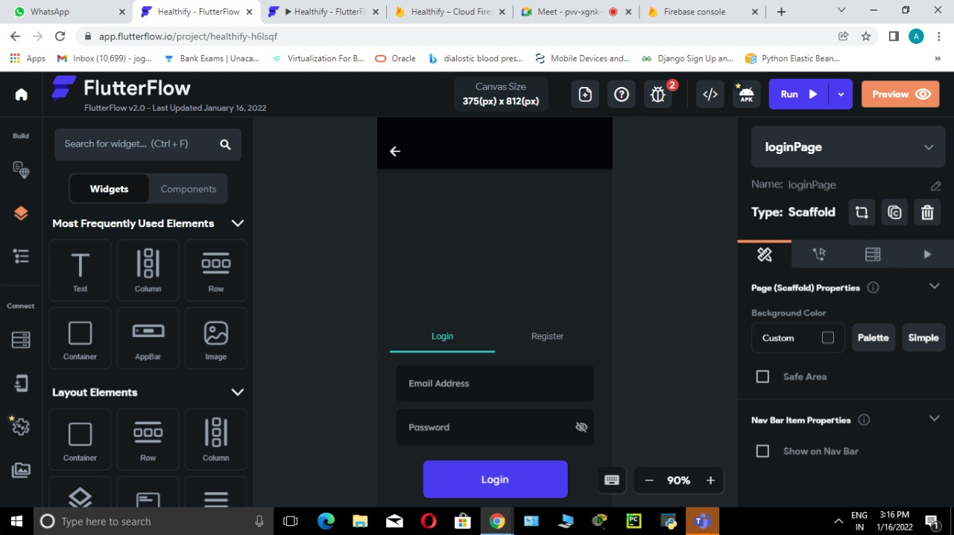
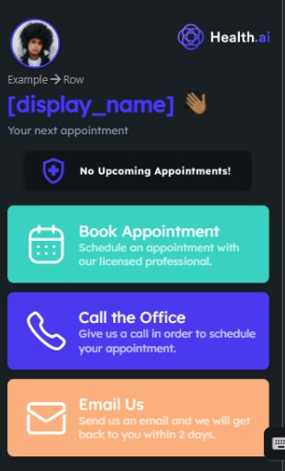
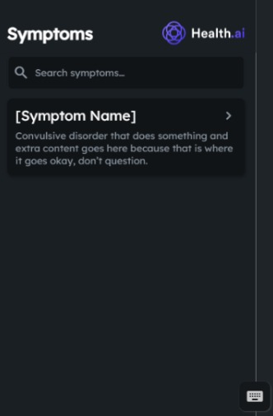
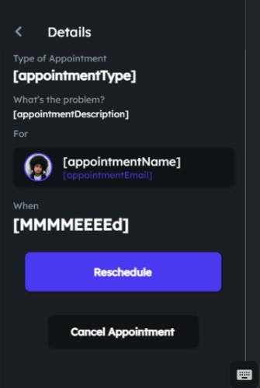
DESIGN OVERVIEW

Slide 24
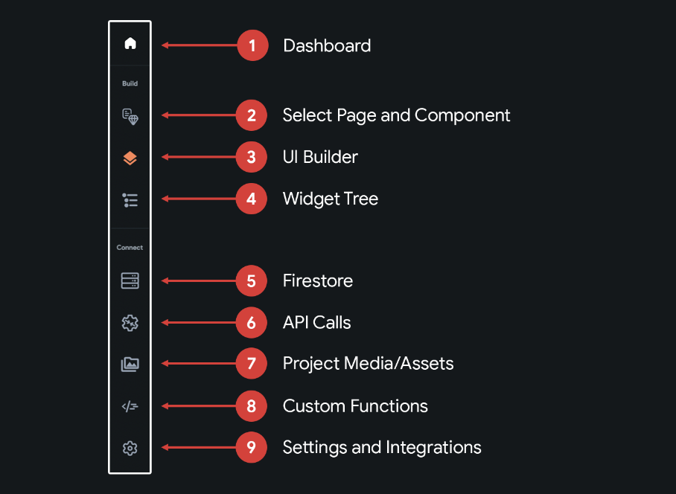
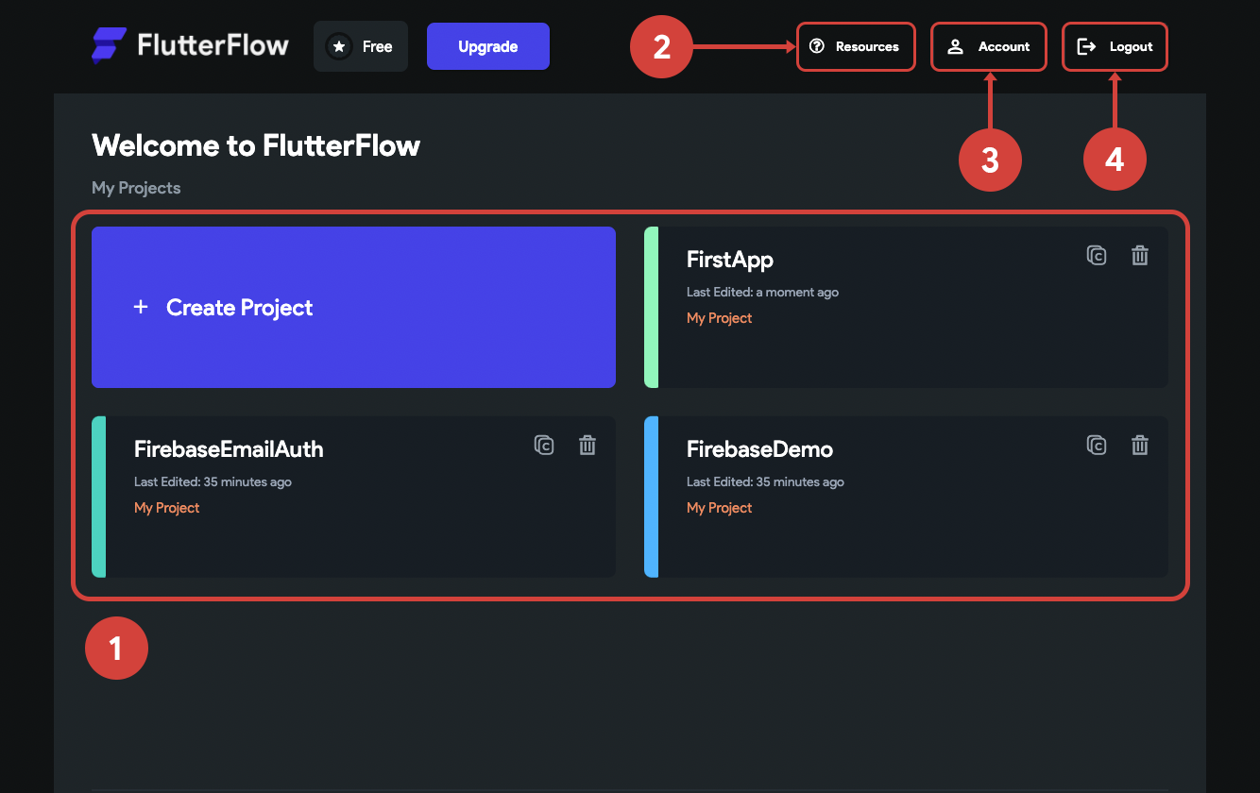
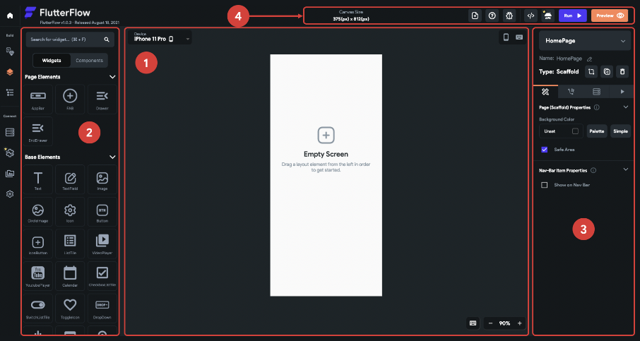
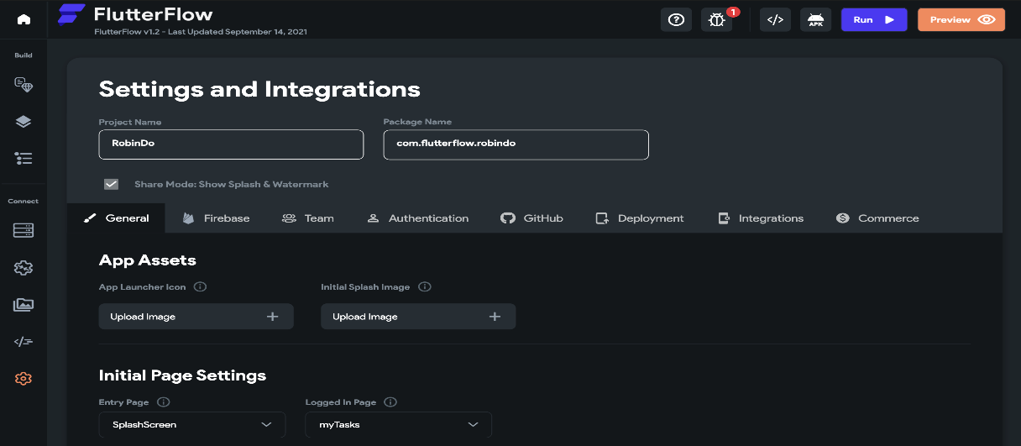
Project Dashboard of Flutterflow
Navigation Menu of Flutterflow
UI Builder of Flutterflow
Design and Integration Menu of FlutterFlow

Slide 25
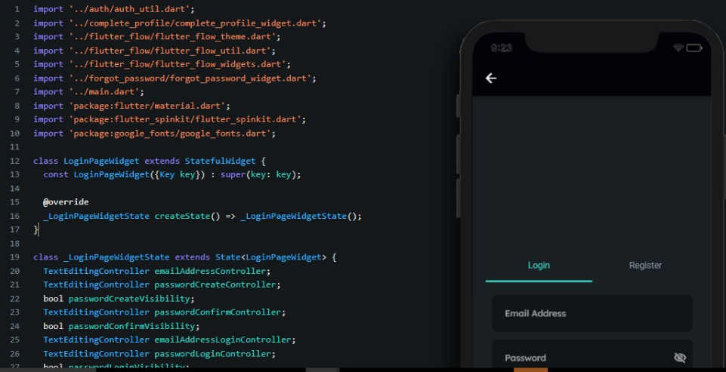
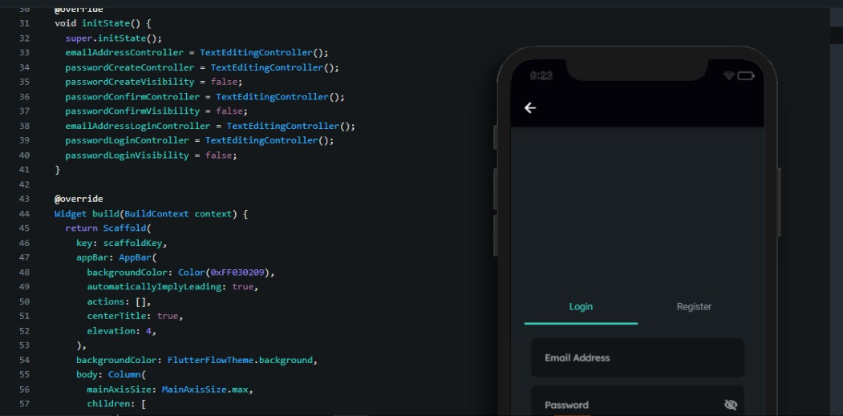
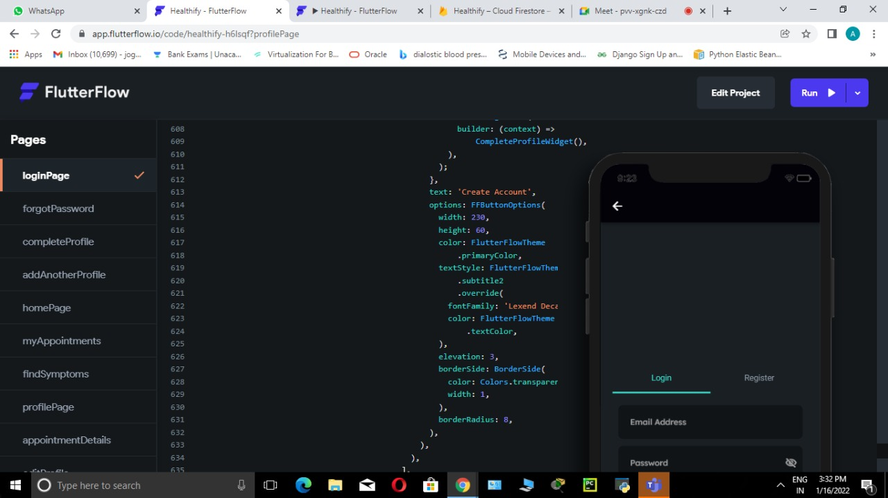
DESIGN IMPLEMENTATION

Slide 26

CONCLUSION
Health care Technologies include medical devices that are used in home as well as Digitally such as Home-Based healthcare.
Four main objectives in this area are :
1. Regulating technologies for healthcare consumers.
2. Developing Awareness among people about healthcare technologies.
3. Privacy and security of data.
4. Ensuring that consumers who are needy get benefited from these technologies.

Slide 27
REFERENCES
1. https://firebase.google.com/docs
2 . https://docs.flutterflow.io/
3 . https://firebase.google.com/docs/rules/
4 . https://www.youtube.com/watch?v=39y_VgNDvok&t=744s

Slide 28
THANK YOU

